Slide 1
VFX Final - X2Face
Team 4
R11922025 陸信丞 R11922036 陳靖元
R11944005 薛博文 R11944024 黃秉茂

Slide 2
Outline
Introduction
Methodology
Implementation
System
Research
Demo
Reference

Slide 3
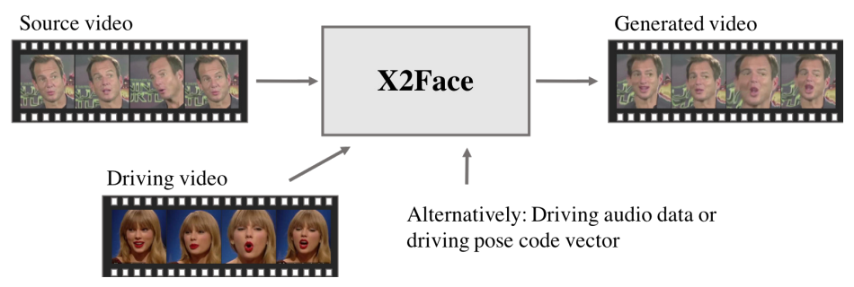
Introduction
Image editing
Source - Identity and Hairstyle
Driving - Properties, Pose, and Expression

Slide 4
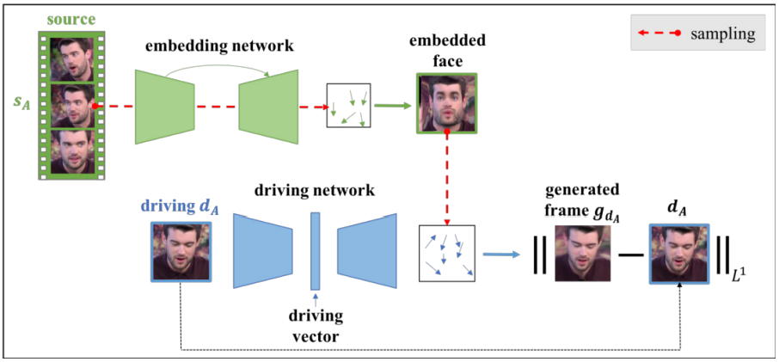
Methodology
SSL
Embedding network
source frame to a face representation
U-Net and pix2pix
Driving network
transform pixels from the embedded face to produce the generated frame
encoder-decoder

Slide 5
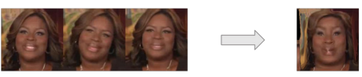
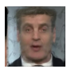


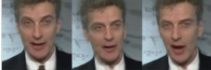
Implementation
Embeded faces generation
Faster inference with pre-generated embedded faces (only need to inference driving network)
fps: 5 -> 30 (6 times faster)
Pre-generated Embedded Faces
Driving Frames
Driving Network
Generated Frames

Slide 6
System and Library
Training
Inference
Real-time
Video to Images
Images to Video

Slide 7
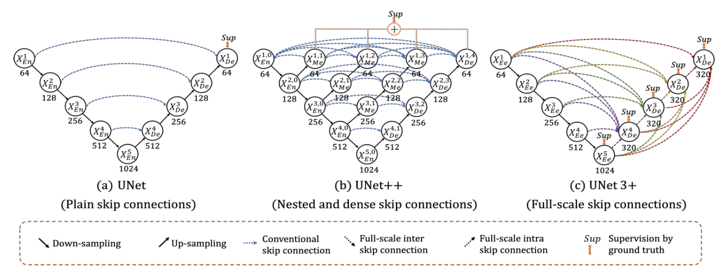
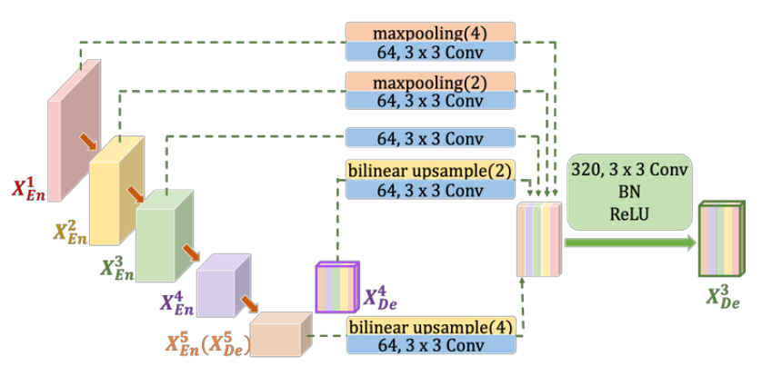
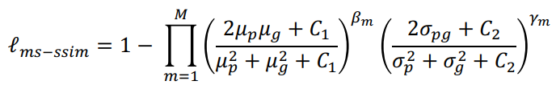
Research
Model Backbone
Unet
Unet 3+
Full-scale Skip Connections
Full-scale Deep Supervision
Reduce the network parameters
More full-scale information
Loss
L1 loss
SSIM loss

Slide 8
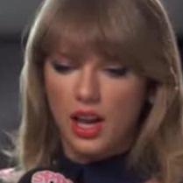








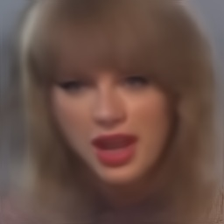
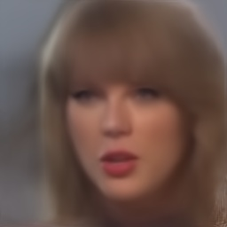
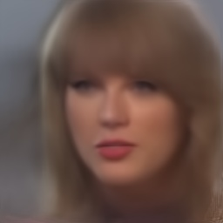
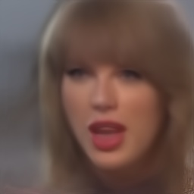
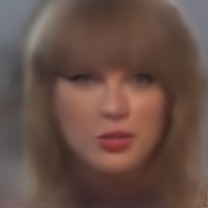
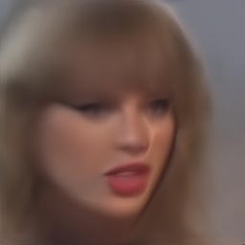
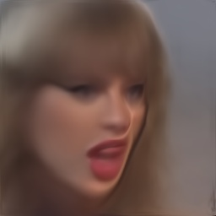
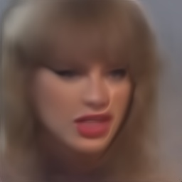
Demo - Offline
Source
Driver
Result

Slide 9
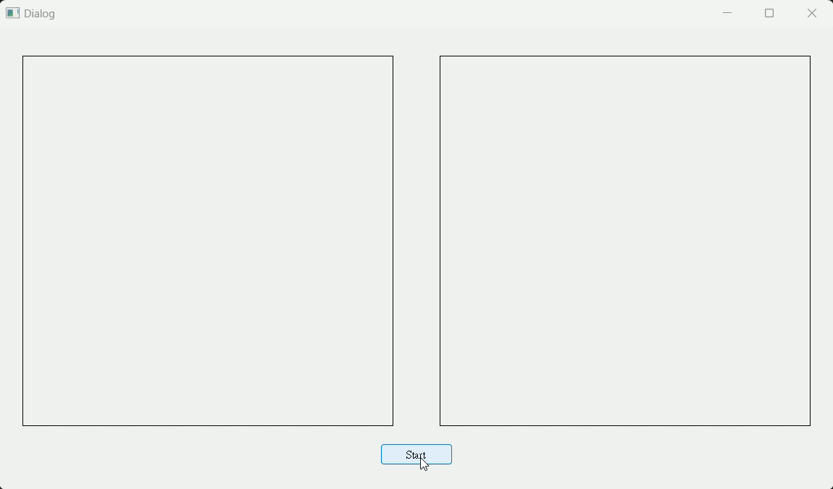
Demo - Online

Slide 10
Reference
X2Face - WILES, Olivia; KOEPKE, A.; ZISSERMAN, Andrew. X2face: A network for controlling face generation using images, audio, and pose codes. In: Proceedings of the European conference on computer vision (ECCV). 2018. p. 670-686.
Unet 3+ - HUANG, Huimin, et al. Unet 3+: A full-scale connected unet for medical image segmentation. In: ICASSP 2020-2020 IEEE International Conference on Acoustics, Speech and Signal Processing (ICASSP). IEEE, 2020. p. 1055-1059.

